Slide 1

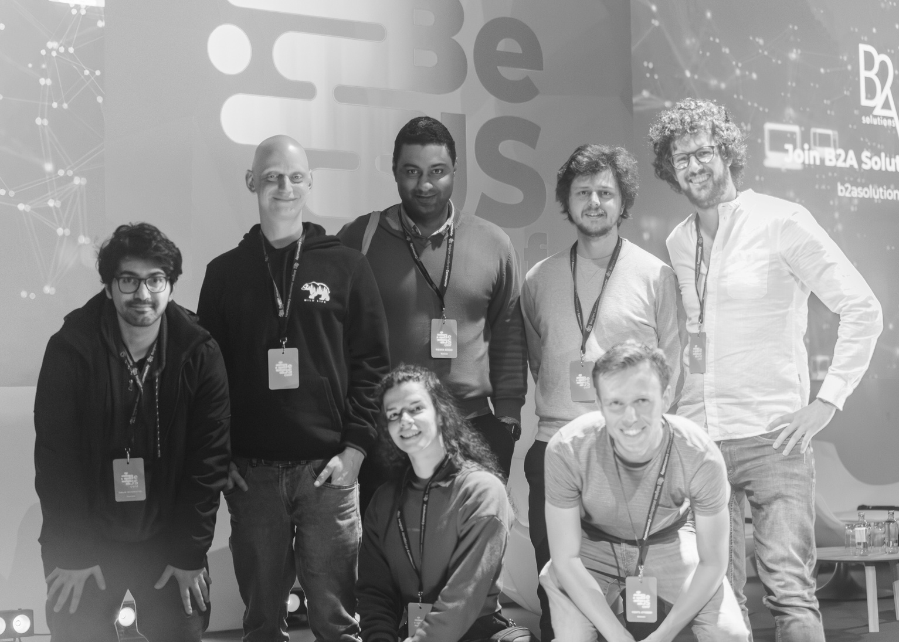
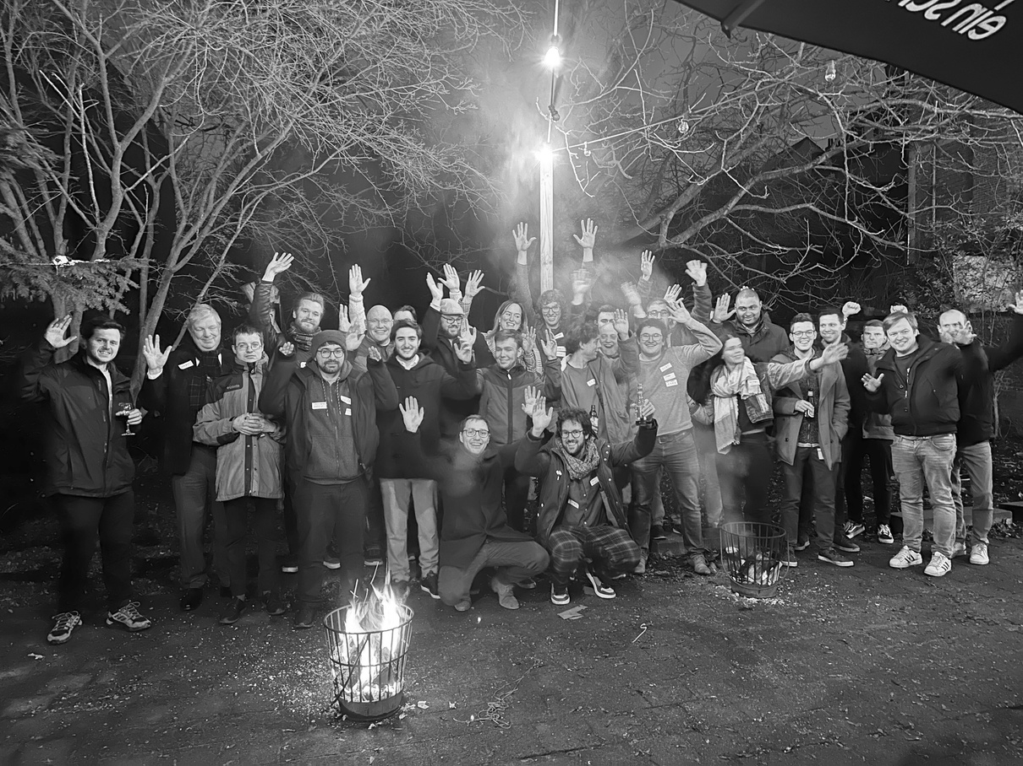


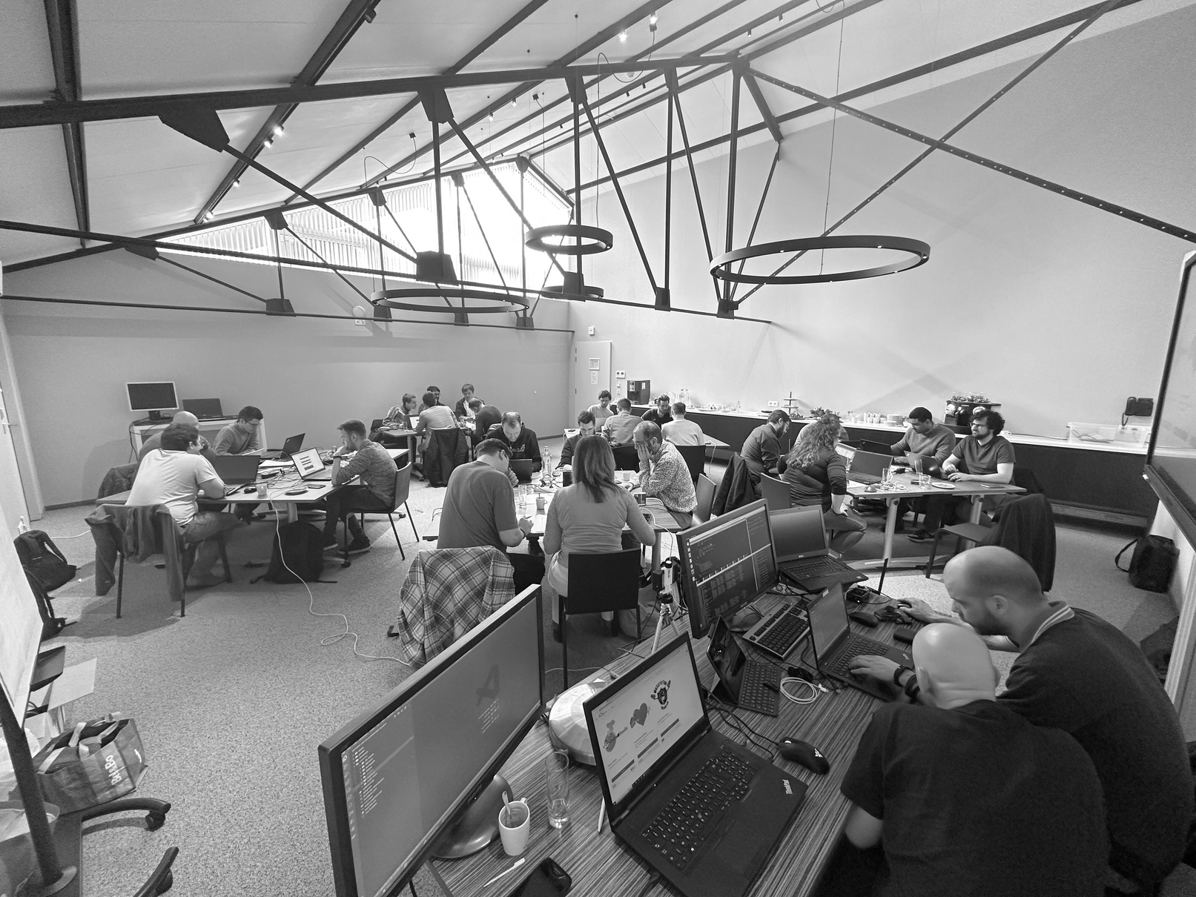

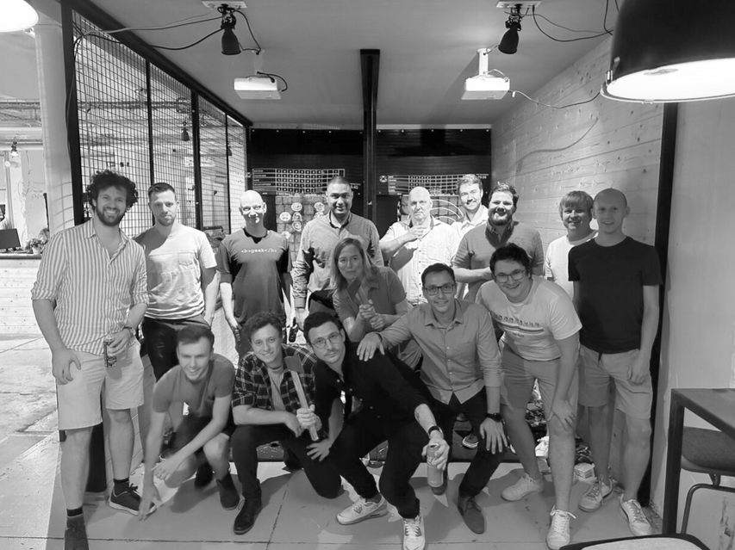


Modern Redux Toolkit
WOUTER VAN SCHANDEVIJL

Slide 2

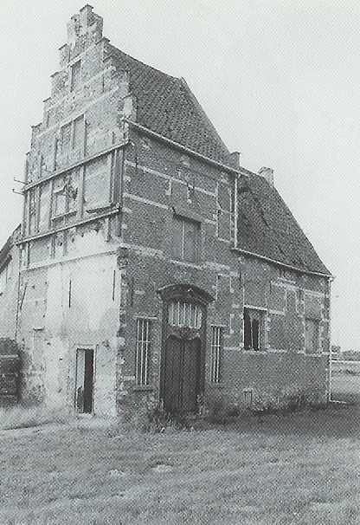
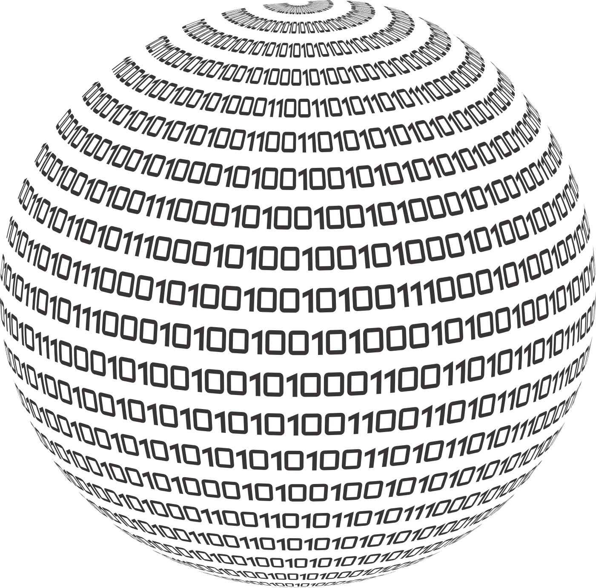




40min
ReduxJS
Toolkit
Demos
Code-Show
War Story
Theoretical
Introduction
FrontendTrack

Slide 3




Menu
Redux
Migration
Legacy
Modern

Slide 4

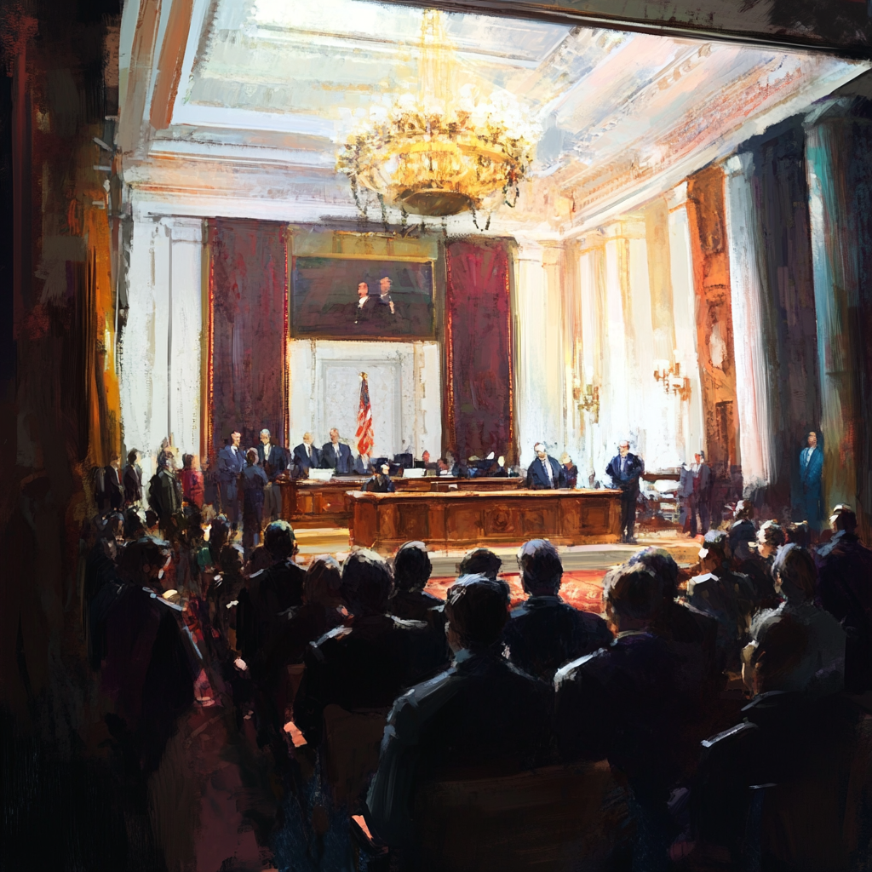

Redux
Quick Recap
Frontend State Management
Avoid passing state through a gazillion components
Best Practices
Do NOT Mutate State
Reducers Must Not Have Side Effects
State & Actions Are Serializable
Single Source Of Truth
State Structure Should Not Be Based On Components
Normalize Data
Derive what can be calculated
Notes:
https://redux.js.org/style-guide/
Do NOT Mutate State: Toolkit uses Immer which greatly simplifies this for you
No Side Effects: State/Actions/Reducers are a StateMachine and are easy to test
Serializable: The toolkit will spawn errors if not. (ie don’t store classes, Promises, functions etc)
State Structure: Single Source Of Truth, is independent from your Components

Slide 5



Migration
of table tennis web site for local club

Slide 6

Migration
JavaScript → TypeScript
PropTypes
Babel
ImmutableJS
Classes → Functions & Hooks
Decorators
Bootstrap 3 → 5
MaterialUI 3 → 6
Bluebird → Native Promises
Jenkins → Github Actions & Docker
EF → EF.Core & .NET 4.8 → ASP.NET 8

Slide 7

Migration
So I was thinking, while we’re at it…
Let’s just switch to reduxjs/toolkit too

Slide 8

Migration
I quickly realized what a mistake that was 😭
Fast-forward one month…

Slide 9
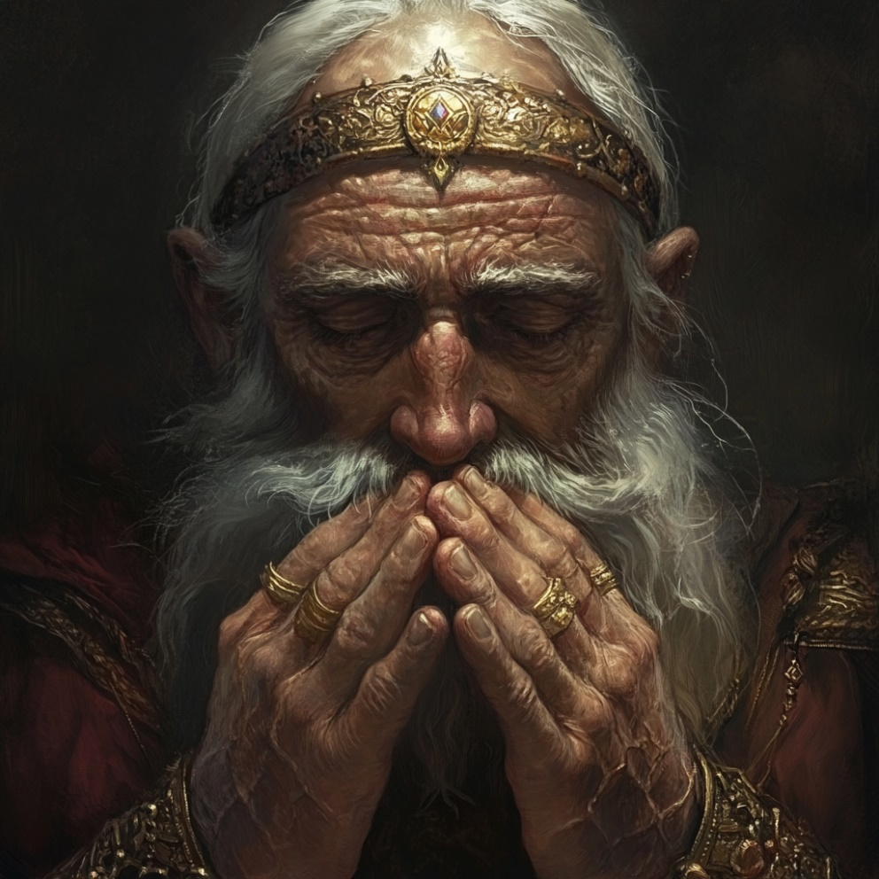
Legacy
The Old Way
Everything is so deliciously untyped
But doesn’t have to be!
It’s not quite NGRX but still, the boilerplate 😱💀
Not sure if there is a single living human that mastered the createStore fn
So how does this compare to reduxjs/toolkit

Slide 10

Modern
The Official Opinionated Way
TypeScript
Boilerplate Reduction with Slices
Easier Immutability with Immer
Batteries included
DevTools
Query & createAsyncThunk
Default Middleware
serializableStateInvariantMiddleware
immutableStateInvariantMiddleware

Slide 11




Let’s look at some code (redux-legacy/src/store/store.ts)

Slide 12








Our Socials
@itenium
@itenium_be
itenium
itenium-be
itenium.be
@itenium
itenium.be

Slide 13



THANK YOU!

